Slide 1
Waveforms
By
Sneha Potdar
Research Assistant
MIRC

Slide 2
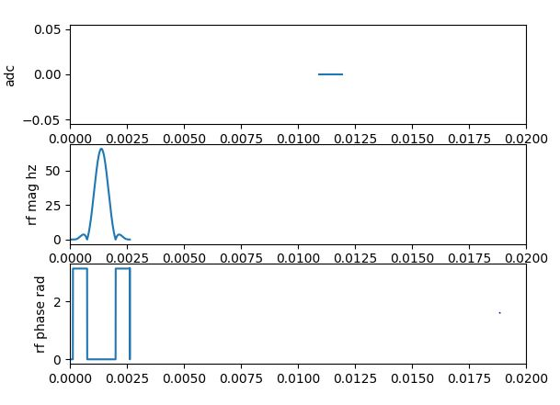
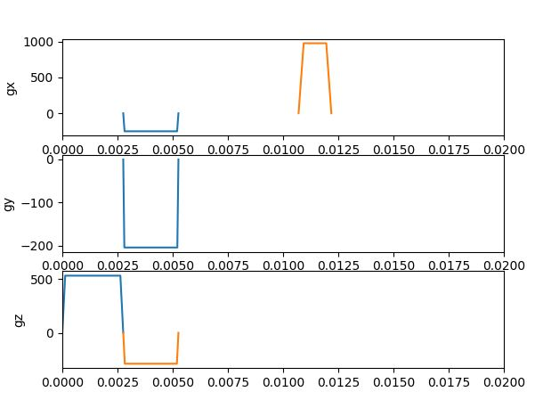
GRE Waveforms
TR = 20 ms and TE = 10 ms

Slide 3
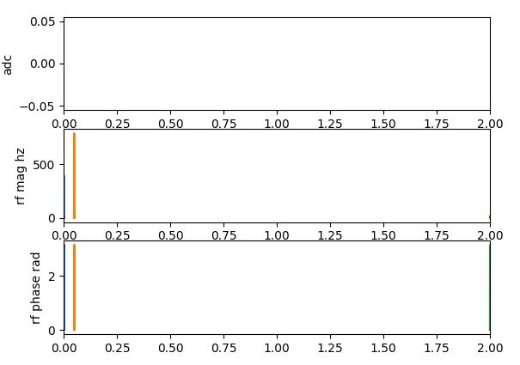
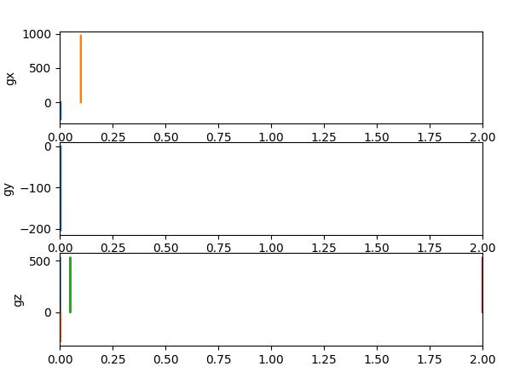
SE Waveforms
TR = 2000 ms and TE = 100 ms

Slide 4
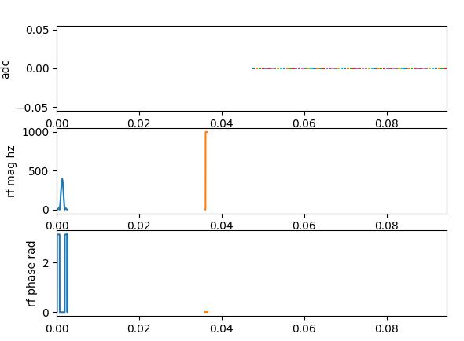
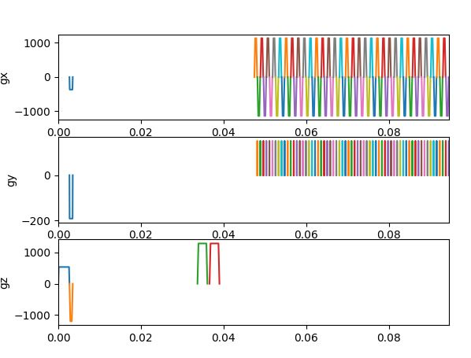
SE-EPI Waveforms
TR = 200 ms and TE = 70 ms

